Slide 1
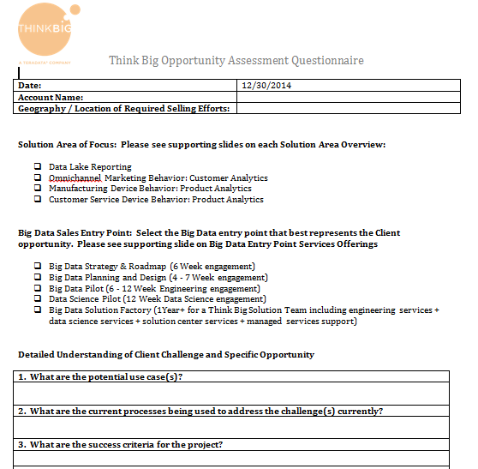
INTERNAL PROCESS:
Think Big Opportunity Assessment Questionnaire
https://connections.teradata.com/community/ps-gateway/americas-consulting-services-gateway/think-big

Slide 2
How to use logo slides in this deck
Slides 11 and 23 are approved for field based customer facing, or internal presentations only.
They are not approved for:
Printed leave-behind materials
Digital copies sent to customers
External websites
Partners presentations or other user groups

Slide 3


Think Big Overview
<Your Name>
<Date>

Slide 4
Who is Think Big?
Think Big helps organizations unlock the value of big data through data science and engineering services

Slide 5
Big Data
What is Big Data?
Data sets so large and complex that they become awkward to work with using standard tools and techniques
Google, Quantcast, Yahoo, LinkedIn… customer innovation in open source
Discover value in dark data and relationships among data sets
Customer behavior
Product behavior
Evolution: insight -> operational -> business innovation
Source: Hortonworks

Slide 6
Four Essential Big Data Business Challenges
Lack of Clear Big Data Strategy
Data Scattered
& Not Well Understood
Difficulty Turning Data into Action
Missing Big Data Skills

Slide 7
Think Big Can Help Solve Your Big Data Challenges
Big Data Strategy & Roadmap
Data Lake Implementation
Analytics & Data Science
Training & Support
Lack of Clear Big Data Strategy
Data Scattered
& Not Well Understood
Difficulty Turning Data into Action
Missing Big Data Skills
As the first and only pure play big data services firm, Think Big is best able to address the business challenges of big data

Slide 8





What Makes Think Big Different From Other Services Firms?
Founded in 2010 with over 100 engagements across 70 clients
Specialize in creating business value from big data
Proven vendor-neutral open source expertise
Agile team-based development methodology
Dedicated Think Big Academy for change management and organizational development
On-shore Solution Center

Slide 9
Proven, Team-Based Methodology
Experiment-Driven Short Sprints with Quick Release Cycles
Data scientists
Data engineers
Expert team working on-site and remotely
CLIENT EXPERTS & SPONSORS
We Accelerate Your Time to Value
Breaking Down Business and IT Barriers
Discrete Projects with Beginning and End
Early Releases to Validate ROI and Ensure Long Term Success
Notes:
Our methodology to delivering value is based on experiment-driven projects where we imagine, illuminate and implement in a short period of time to innovate and realize value.
It is an iterative process as we break down barriers.
Our timeframes are discrete, with a beginning and end. We want to empower your team to continue without us.
We also want to provide early releases to validate your investments and ensure long term success.
In the end, our goal is to accelerate your time to value.
Let me walk you through each of our steps in our methodology.

Slide 10
Think Big Client Experience
Telecommunications
#4 of Top 10 Brands
Internet Transaction Security
#1 of Top 10 Brands
Apparel
#1 of Top 10 Brands
Computers
#1 of Top 10 Brands
Airlines
#6 of Top 10 Brands
Financial Data Services
#4, #5, #10 of Top 10 Brands
Commercial Banks
#7 of Top 10 Brands
Semiconductor
#1 Top 10 Brands
Computer Peripherals
#1,#2 of Top 10 Brands
Disk Drives and Data Storage
#1 and # 3 of Top 10 Brands
Network Communications
#2 & #3 of Top 10 Brands
Retailers & Specialty Retailers
#1 and # 2 of Top 10 Brands
Financial Exchanges
#2 of Top 10 Brands
Securities
#1 & #6 of Top 10 Brands
Social Network
#1 of Top 10 Brands
Internet Services & Retailing
#3 of Top 10 Brands

Slide 11






























Accelerating Value for Industry Leaders
NDA
Be careful how you use
this slide. Use the preceding one if you plan on leaving materials behind
#1 Consumer Electronic
Streaming music company
#1 Global Sports
Brand
Asset Management
#1 Discount Retailer
Notes:
Our differentiators - speed, expertise, onshore experience - That’s why leading companies are turning to us to help them drive value.
Our clients span diverse industries and sectors. But ultimately all are trying to generate new insights from big data.
And we are helping them do that… with great results.
For example, [review case examples]

Slide 12
ROI for Manufacturing Client: Est. at $11M year 1, $30M cumulative year 2
Year 1 Estimates
Enhanced product through predictive failure
$1M additional sales
Improve Yield
$6.5M material savings
More Efficient Data Search
$3.5M productivity gains

Slide 13
Big Data Strategy & Roadmap

Slide 14
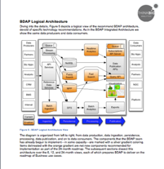
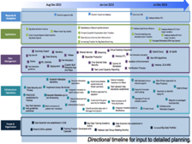
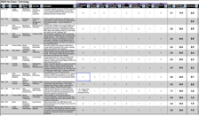
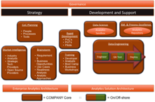
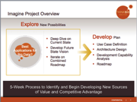
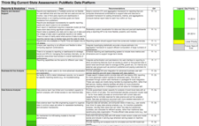
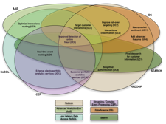
Big Data Roadmap: Engagement Model
Objective: Develop a Big Data strategy, architecture, and 12 Month roadmap
2 weeks
2 weeks
1-2 weeks
1-2 weeks
Discovery
Architecture Definition
Readiness Analysis
Roadmap & Recommendations
Collaborative business and technology workshops
Identification and prioritization of high-value use cases
Architecture recommendations
Finalize use case list and perform criteria scoring
Development of capability definitions including organization and training
Analysis of use cases against current and future technology, organization and data
Creation of 12-month roadmap based on priorities
Executive Presentation
12-Month Roadmap
Use Case Prioritization
Architecture Definition
Capability Definition
Use Case Matrix
Executive
Presentation
Use Case Scoring Criteria
Use Case Mapping

Slide 15
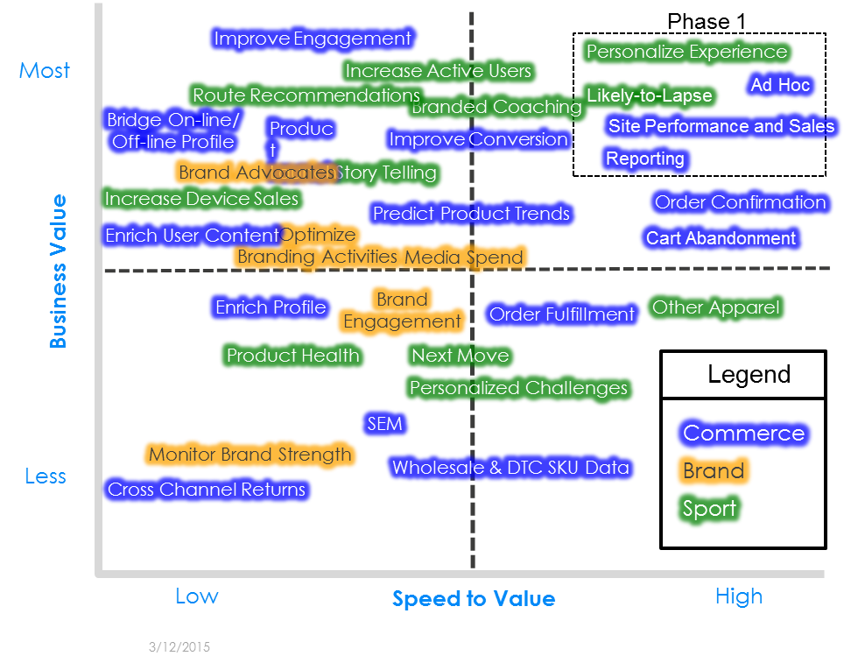
Discovery – Use Case Definition Report
Use Case Definition
Architecture Definition
Capability Definition
Roadmap & Recommendations
A full day kickoff with key stakeholders
Focused workshops with business and technology units
Locate suitable data sources for Big Data enhancement and analytics.
Identify overall list of use cases and business value levers
Finalize scoring and ranking of use cases
Notes:
READINESS NEEDS TO BE SPEED TO VALUE
REDO SOME IMAGES SO THAT THEY ARE WHOLE IMAGES, NOT JUST SCREENGRABS
TEST THE PRESENTATION ON A BIG SCREEN FOR FINAL TEST

Slide 16
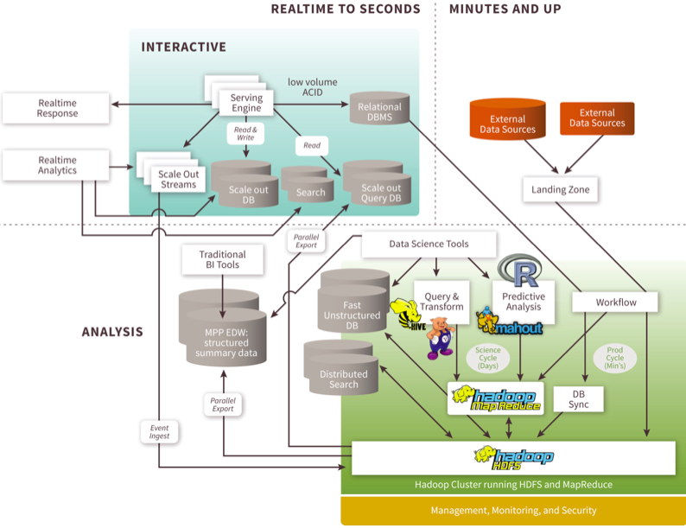
Architecture Definition
Use Case Definition
Architecture Definition
Capability Definition
Roadmap & Recommendations
Use prioritized use cases to identify patterns for technologies and platforms that drive Big Data ecosystems.
Instantiate Think Big’s reference architectures based on the prioritized use cases.

Slide 17
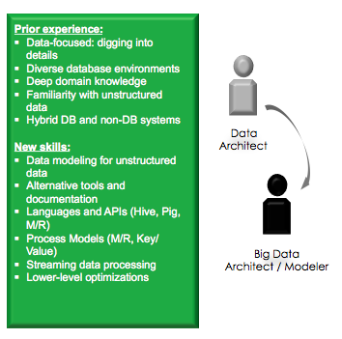
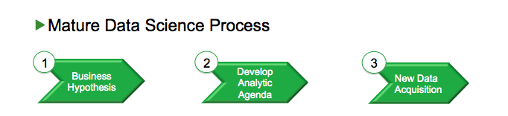
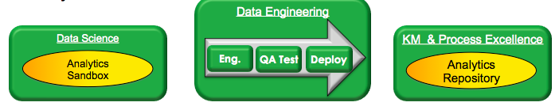
Capability Definition
Use Case Definition
Architecture Definition
Architecture & Capability Definitions
Capability Definition
Roadmap & Recommendations
Describe each component of the architecture, especially for people, process, and technology
Identify requirements and challenging aspects
Decisions and processes to meet requirements and address challenges

Slide 18
Roadmap & Recommendations
Use Case Definition
Architecture Definition
Capability Definition
Roadmap & Recommendations
Sequence use cases and supporting capabilities across 12 month Roadmap
Develop 6 month action plan, required investment and business justification
Develop Executive Presentation
0-6 Months
7-12 Months
13-18 Months
19-24 Months
Use Cases
Customer Interactions
Interactions classification
Improve roll-over targeting
Real-time event tracking
UC3 – Target Customer Interactions
Target customer interactions
Advanced features
Optimized interactions routing
Macro market sentiment
Flexible search for profile
Analytics
Customer analytics services
External clients analytics services
Authentication & Fraud
Simplified authentication
Improved detection of online fraud
Technology Capabilities
Clickstream data on Hadoop
Email, chat, survey & phone data
Reference, market data
External data (e.g. Social, MRN)
Semantic processing and Search
Greenplum/SAS AAE
Transition to NoSQL
Cloud-based analytics
Stream processing
Data science on MPP plus Hadoop
Big Data BI Reporting
Data transformation / Aggregation / Publication
Interfaces to operational applications
Jul 2014 – Dec 2014
Jan 2015 – Jun 2015
Jul 2015 – Dec 2015
Jan 2016 – Jun 2016

Slide 19
Big Data Roadmap Deliverables
Deliverable | Description
Use Case Matrix & Definition | Prioritized list of uses cases where big data can drive significant business value. Includes a detailed description and (big data) recommendations for the top use cases.
Architecture Design | Architecture design to support the identified use cases & Big Data initiatives. Includes a gap analysis & big data readiness assessment.
Capability Definition | Recommended organizational structure, governance, and functional roles to sustain Big Data initiatives.
Big Data Roadmap | 12-month visual Big Data roadmap that layers Big Data initiatives with client milestones.
Executive Presentation | Executive summary of findings and recommendations.

Slide 20
Data Lake Implementation

Slide 21

What is a Data Lake?
A “Data Lake” is a centralized approach to capturing, refining, storing, and exploring any form of raw data at scale, enabled by low cost technologies from which downstream facilities may draw
Data Variety is the driving factor in building a Data Lake
Notes:
Cut through the hype
Three Big Ideas
Data Warehouse déjà vu?
When you cut through the hype, most proponents of the Data Lake concept are promoting three big ideas: that you should capture all data in a centralized, Hadoop-based repository (whatever all means); that you store the data in a raw, un-modelled format; and that doing so will enable you to break down the barriers that still inhibit end-to-end, cross-functional Analytics in too many organisations.
Now that is a lofty and worthwhile ambition – but at this point in the conversation, many of you could be forgiven a certain sense of déjà vu. Because improving data accessibility and integration are what many of you thought you were building the Data Warehouse for.

Slide 22
Why a Hadoop Data Lake?
Establish a well managed repository of any data
Benefit from open source big data innovation and cost savings
Control over enterprise data with governance
Establish more consistency for business insights
Govern who, what and when data is accessed or provisioned
Track usage, resolve anomalies, visualize, optimize and clarify data lineage
Offload history of operational and analytical data platforms
Gain ultimate flexibility in data use and access
Schema on read, lightly conditioned, un-modeled, flexible modeling
Adding flexible NoSQL programming options
Foundation for solving business problems
Enables new uses of data via working with new data sets and analytics

Slide 23












Data Lake – Innovation and Value
Our Clients:
Customer Value Drivers:
Democratize Data Access
Reduce cost of data management infrastructure
Reduce ETL spend
Establish metadata management & data governance
Analysis over much larger and varied data sets
Increase analytics cycles
Leverage new data in reporting, BI and traditional analytics
Notes:
Modify for Data Lake Reporting

Slide 24
Example: Enterprise Data Lake Business Value
Enterprise-wide data access for timely analytics and insights
Foundation for large scale proactive analytics
Reduce $Millions in scrap waste
Drive revenue and market share by accelerating time to market
 | Legacy | Data Lake
Retention | 3-6 months scattered DBs then tape archive | All data online in common data lake for 3+ years
Coverage | Summaries, samples for several data sets | All parametric data captured in raw and integrated form
Analysis | Reactive resulting in missed improvement opportunities | In daily operations and on larger data sets to support proactive improvements

Slide 25
Data Lake Services
Data Lake Starter
Stand up a Data Lake and build 2-3 governed batch data ingest streams
Ingest and governance building, start small, scale fast
Data Lake Optimization (for an existing Data Lake)
Add governance and best practices to your existing Data Lake/Hadoop deployments
Data Lake Dashboard Reporting
Build Dashboard Analytics – Deep insight via existing Hive table using JavaScript dashboard, Tableau and other BI tools
Enable business insights from a new or existing data lake

Slide 26
Data Lake Optimization
Data Lake Gap assessment – 4 week fixed cost program
Output is a report, a plan and a set of recommendations
Planning & Architecture – governance assessment of 2 ingest streams
Performance & Stability assessment
Data Lake Cluster Analysis – recommendations, gap analysis, HA, configuration adjustments
Review of lineage and recommendations on metadata and data management
Recommendations on security, compliance and archive capabilities
Option for a 3 month Rainstor trial
Review of current data lake reporting capabilities
Option for a 3 month Think Big Dashboard Reporting trial with Tableau

Slide 27
Data Lake Starter Service
Enables a rapid build for an initial Data Lake
Planning & Architecture – joint design for well governed ingest streams, downstream use cases
Data Lake Build - Provide recommendations and assistance in “standing up” a 8-16 node data lake on premises or in the cloud
Install, configure, integrate and train use of the reservoir metadata service
Implement and document 2-3 batch data streams, tracking data lineage from source to Hive accessibility
Setup security, compliance and archive capabilities with Rainstor for a 3 month trial
Comprehensive end-to-end system integration test executed jointly
Optionally prototype data visualization with Think Big Dashboard Reporting trial

Slide 28

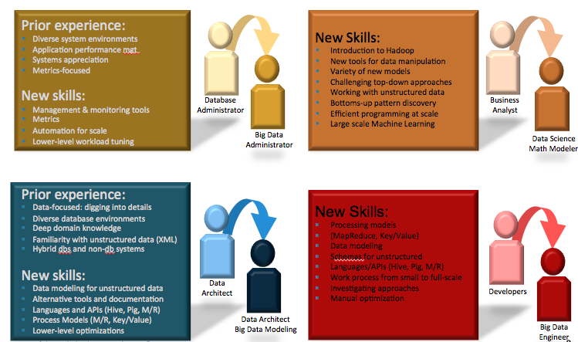

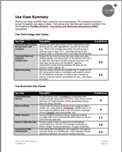


Example: Data Lake Starter Service
2 weeks
2 weeks
2 weeks
2 weeks
Design
Build & Test
Integrate & Tune
Assess, Mentor & Plan
Collaborative workshops with business groups
Identification and prioritization of high-value data streams
Gap analysis
Develop Ingest workflows
Install Metadata and Info Security Services
Prepare Cluster for Integration test
Install Ingest & System Test
Begin Profiling Data
Learn about Information Security and data wrangling
Begin Building DL Reporting
Final tuning, assessment and next steps
Data Stream Prioritization
System Integration Testing
Organization & Training
Develop & Unit Testing
Info Security Objectives
Follow-up Roadmap
Data
Sources
Software Component Installation
Data Profiling and Capability
Cluster configuration & Integration
Executive
Presentation

Slide 29
Analytic and Data Science Solutions

Slide 30
Data Science Overview
Data Science Project
11-25 week(s)
Data Profiling and Exploratory Analysis
3-6 weeks
Analytics Modeling
3-6 weeks
Project Kick-off
1-2 week(s)
Model Publishing
2-8 weeks
Reporting
1 week
Model Validation
1-2 week(s)

Slide 31
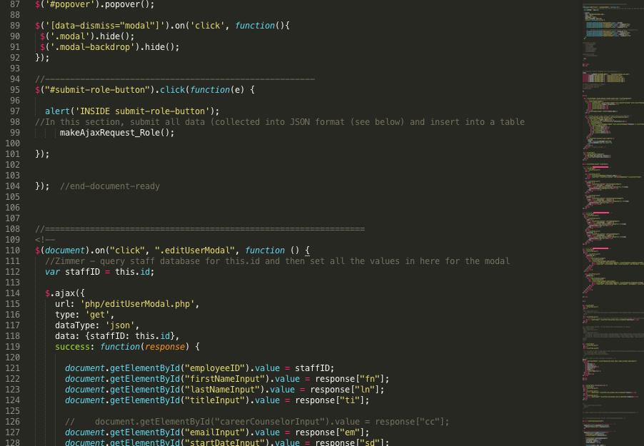
Data Science Project Timeline
Data Profiling and Exploratory Analysis
3-6 weeks
Analytics Modeling
3-6 weeks
Project Kick-off
1-2 week(s)
Assess business/use case
Define analytics agenda to address use case
Define validation strategy to assess impact of solution
Define outcomes of analytics efforts
Review agenda, validation, and outcomes with clients
Identify and investigate data sources
Review data definitions with data owners/SME
Univariate and bivariate descriptions of data
Search for latent variables in data
Initial modeling of target outcome variable(s)
Quantify target outcome
Develop initial models of outcome variable
Iterate models by adding variables, increasing complexity, and joining multiple models (ensembles, model chaining composite models, etc.)
Data Definition Document
Analytics Modeling Code
Project Definition
Report
Exploratory Analysis Code
Notes:
Kick-off:
Team Definition with functional roles and skill profiles
Expanded Use Case Definition
Sandbox Architecture Design
Rent/Build Balance Roadmap
Setup Data Lab:
Data lab
Use Case Approach Document
Execution:
Dashboard with summarized insights
Use Case Executive Presentation

Slide 32
Data Science Project Timeline
Model Publishing
2-8 weeks
Reporting
1 week
Model Validation
1-2 week(s)
Translate established validation strategy into statistical code
Assess model over existing data in a cross-validated design
Capture outcome criteria and model performance
If needed, translate final model to a production-approved language
Integrate model to production service, dashboard, or report
Capture & document approach to use case
Capture and document technological approach
Capture and document model performance from validation stage
Identify and document recommendations and next steps
Production Model Code
Performance Assessment Code
Production System
Use Case Report
Runbook
Executive
Presentation

Slide 33
Data Science Deliverables
Deliverable | Description
Project Definition Document | Outlines client goals, selected approaches, expected outcomes, and approach to assessing success
Data Definition Document | Technical document outlining data sources, data features, feature characteristics, and understood meaning of features
Use Case Report | Summarizes use case goals, approach, results, and next steps; for a mixed audience. Technical information in appendices.
Runbook | Explains how to run and debug code; for a technical audience
Executive Presentation | Presentation summarizing efforts, insights, and recommendations for a non-technical audience

Slide 34


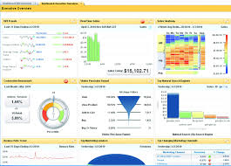





Dashboard Engine for Hadoop
Dashboard Engine
Events
TRANSFORM
AGGREGATE
INGEST
Reporting, Visualization and Analytics
Traditional BI on Hadoop
Dashboard Engine
Day or week old data
Long latencies to retrieve data
Doesn’t scale as number of events, aggregates, or users grow
Expensive, siloed event analytics
Real time data
Unlimited custom reporting (drill to billions or trillions of aggregates)
Latencies under a second
Scales easily for thousands of simultaneous users
Open source omni-channel analytics

Slide 35
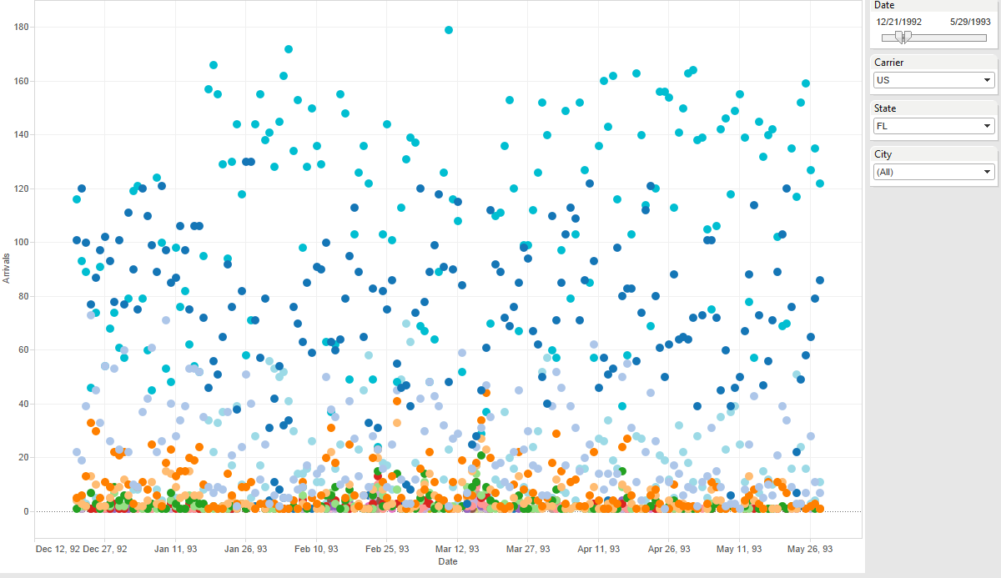
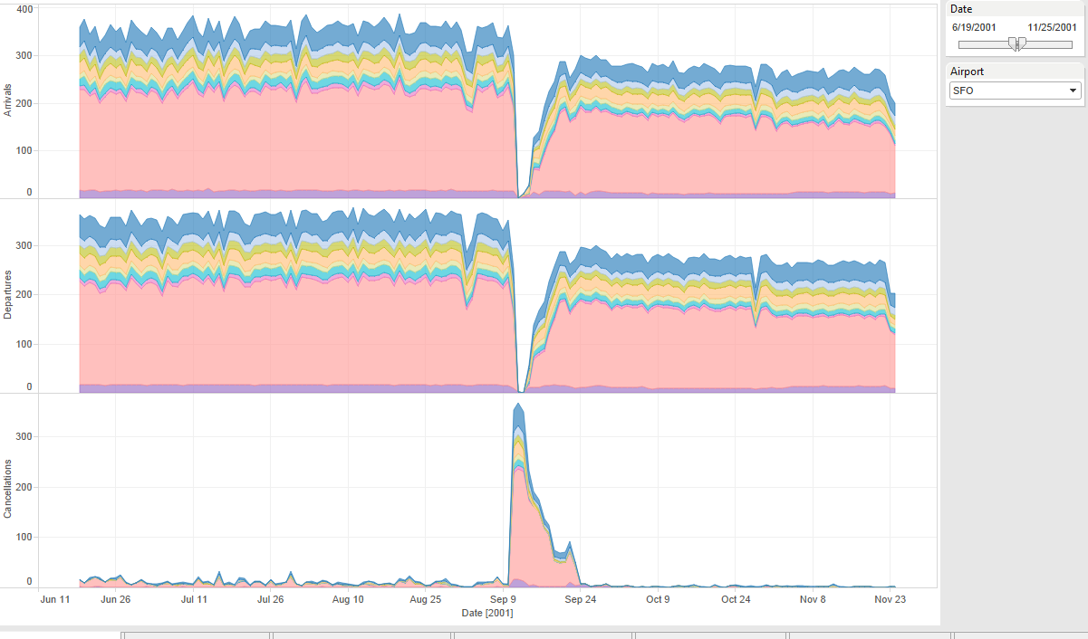
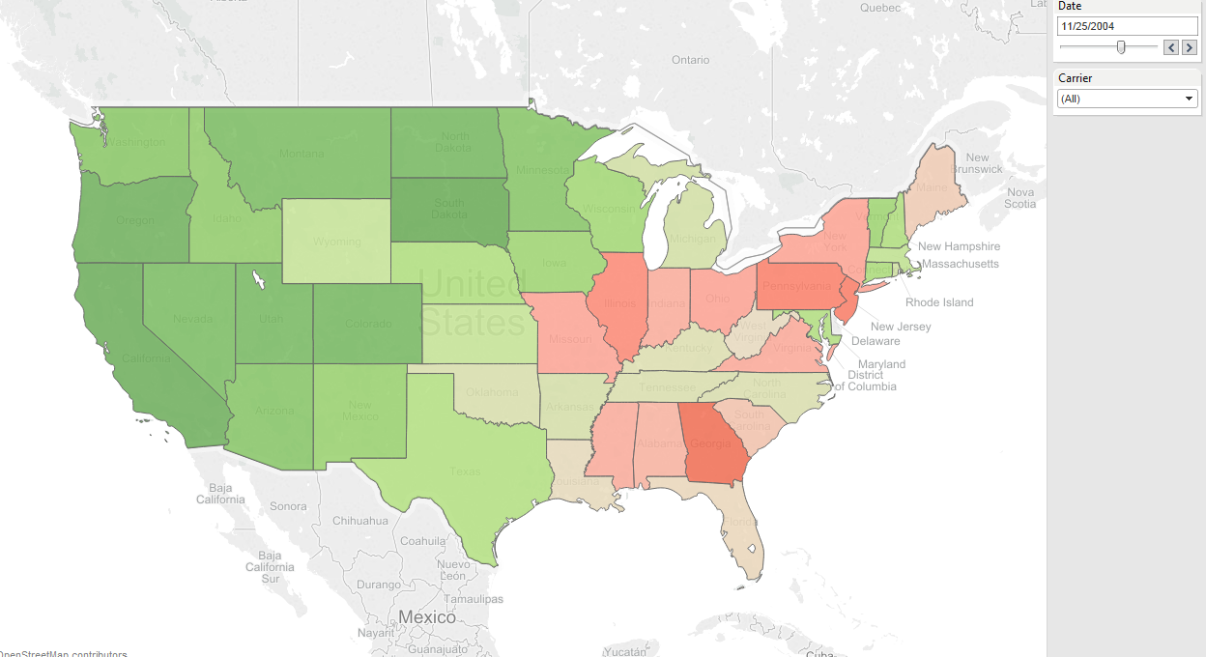
Dashboard Engine Works with BI Tools Like Tableau
Other solutions for BI Tools with Hadoop
Dashboard Engine
Direct connects involve very long latencies to retrieve data
Extracts just look at a small window into the data
Dashboard views can query from trillions of aggregates in under a second
Deep drill down capability on dimensions
All queries use a live connection—no extract or middle-tier database

Slide 36
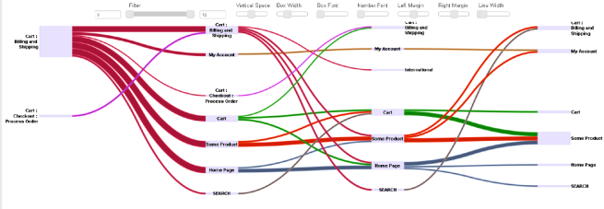
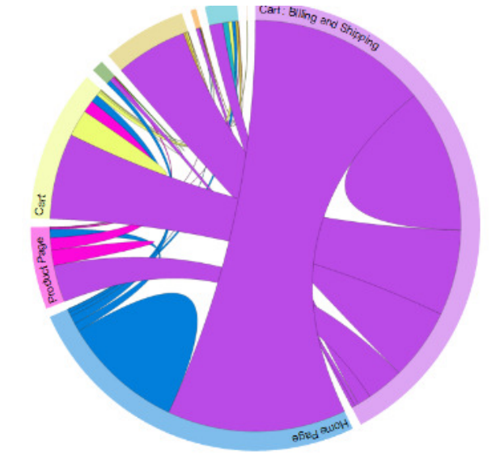
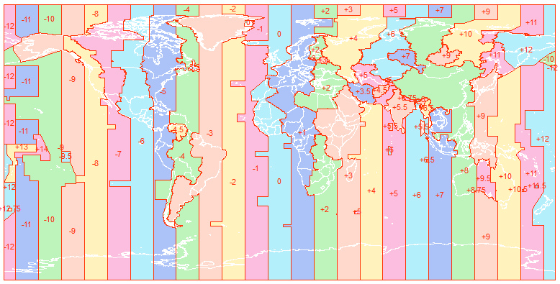
Advanced Features for Dashboard Engine for Hadoop
Cutting-edge visualizations
Many event feeds. One dashboard
AddCart
Buy
Browse
Report on Multiple Timezones

Slide 37
Dashboard Engine for Hadoop Does the Heavy Lifting For You
Entirely meta-data driven
Get professional and real-time analytics from Hadoop
You declare what metrics, dimensions and aggregates you want
You say how the metrics and dimensions are extracted from each event record
Dashboard Engine for Hadoop does the rest
You don’t need to be a Hadoop expert to be expert with your data.

Slide 38
Ongoing Support

Slide 39
Why Use Managed Services?
Offload administration and support
To focus on Business applications
Reliable and predictable platform management
To enable planning and budgeting
Flexible levels of support
To ensure successful outcomes at optimum cost
Work closely with client’s development teams
To assure success in Big Data Strategy
Enables faster adoption of Big Data technologies
© 2015 Think Big, a Teradata Company
7/6/2015

Slide 40
Managed Services for Hadoop
Platform Support
Administration, monitoring and support of the Hadoop Platform and Services
Application Support
Job monitoring, enhancements and ongoing application support for Think Big-developed and/or customer-developed Hadoop applications
Staff Augmentation
FTE’s dedicated to support customer teams

Slide 41
Managed Services for Hadoop – Platform Support
Administration as a Service – Shared Resources
Shared Hadoop Administrators; up to 50 nodes total; max of 2 clusters
Tasks Supported | Core System Administration services including Hadoop cluster administration and support, user management, resource management, performance management through service requests
What’s Included | Daily cursory / Weekly detailed system health checks Monitoring of Hadoop platform services, resources availability Next day response for incidents or service requests Pre-determined bucket of support hours Minor software upgrade & patches – customer manages testing, remediation and supervision Diagnose and fix issues with the Hadoop platform; escalate to vendor where necessary
Resource Model | Shared Pool of resources; Transition Management, Offshore Support and Service Management
Typical Commitment | 1 year or 3 years
© 2015 Think Big, a Teradata Company
7/6/2015

Slide 42
Managed Services for Hadoop – Platform Support
Administration as a Service – Dedicated Resource
Dedicated Hadoop Administrator; up to 50 nodes total; max of 2 clusters
Tasks Supported | Core System Administration services including Hadoop cluster administration and support, health checks, user management, resource management, performance management. Also includes support to monitor data load jobs
What’s Included | Daily / Weekly system health checks Monitoring of Hadoop platform services, resources availability Break fixes as needed during the shift Proactive notifications and planning for resource and capacity management Minor software upgrade and patch installs – customer manages testing, remediation and supervision Diagnose and fix issues with the Hadoop platform; escalate to vendor where necessary
Resource Model | Dedicated Administrator; Defined shift; Transition Management, Offshore Support and Service Management
Typical Commitment | 1 year or 3 years
© 2015 Think Big, a Teradata Company
7/6/2015

Slide 43
Hadoop Platform Support Administrator as a Service – Package Options
Description of item | Shared | Dedicated
Max Clusters (up to 50 nodes) | 2 (Prod + QA) | 2 (Prod + QA)
Health check frequency | Weekly | Daily
Tickets (pre-defined tasks) | 20 tickets / month | 40 tickets/month
Change Requests | 2 / month | 10 / month
Reports (Basic or Rolled-up) | Basic checklist – no roll-up / summary reports | Monthly + Quarterly (Summary, Perf)
Ticket response | Next business day | In supported shift
Monitor Data Load Jobs | No | Yes
Security – Kerberos | Basic | Basic
Weekend and Off-shift (P1) add-ons | Not available | $33K / $38K
Transition (4 weeks) deliverable | Online Ops manual | Run book
1 year Service price + transition (once) | $85K | $130K
3 Year Price w/ transition | $74K per year | $115K per year
© 2015 Think Big, a Teradata Company
7/6/2015

Slide 44
Advantages of Think Big Managed Services
Transition management is key to engagement success; we have completed 200 transitions!
Dedicated service manager for ensuring optimum alignment with customer objectives for Big Data initiative
Gain a single service vendor for existing Teradata customers
Single vendor support for Hadoop environment and applications
Think Big personnel are trained and certified in multiple distributions. All resources undergo mandatory training in our methodologies.
Global development centers in US, India and Philippines using state of the art high security facilities (ISO 27001:2013 certified)
Partner access to CDH and HWX engineering team to quickly resolve software issues

Slide 45

Training and Education
Enable Your Analysts & IT Staff with New Skills
Build Capabilities to Manage Rapid Innovation with Big Data
Invest in and Scale Skills to Create a Data-Driven Organization
Data Architect
Database
Administrator
Business
Analyst
Developers
Data Architect Big Data Monitoring
Big Data
Administrator
Data Science
Math Modeler
Big Data
Engineering
Skills Transformation
Side-by-Side Mentoring
Joint Application Development
Expert Training Courses

Slide 46
Think Big Academy
Clients and Prospects
Classroom Training
Workshops & Mentoring
Employees
New Hire Bootcamp
Coaching and Support for Speaking and PR Opportunities
Public and Partners
Classroom Training
Conferences, Meetups, Webinars
Custom Classes & Programs
Curated Self-Study Resources
Recruiting Events

Slide 47
Popular Current Offerings
Hands-on, technical courses:
Hadoop Developer Course (3-4 days)
Introduction to Hadoop & HDFS; Java MapReduce API; Hive; Extending Hive with Java; Pig
HBase Developer Course (1-2 days)
Introduction to Hadoop & HDFS; HBase Architecture; Schema Design; Java API; MapReduce & HBase
Hive and Pig for Analysts (2 days)
Introduction to Hadoop; Review of SQL; Hive; Pig
Data Science with R (2-3 days)
Introduction to Hadoop; Review of R; Big Data with RHadoop; Parallel Random Forests with RHadoop

Slide 48
Use Cases &
Case Studies

Slide 49
Full Lifecycle Engagement: For a high tech manufacturer
Expected to store over 2PB of support data by 2015
Reduced Critical Customer Support Tickets by 350%
PRODUCTION
Production Kickstart (16 weeks)
Architecture, Data Ingestion, Transformation
Deep analysis of event data
Performance testing
VALUE CONFIRMATION
Detailed Architecture Design
Confirmation of Use Case(s)
Technology selection
ID Critical Success Factors
POC Deployment
Data ingestion
Data transformation
Initial analytics & visualization
VALUE IDENTIFICATION
Production R1&2.0 (32 weeks)
Big Data Production Platform
Internal/external application integration
Mature data governance
Agile 8 week iterations
Big Data Roadmap
Use Case ID & Prioritization
Solution Architecture Design
Capability Assessment
12-18 month deployment roadmap
Implementation & support
Implementation
48 weeks
Strategy
8 weeks
6 weeks

Slide 50
Full Lifecycle Engagement: For a high tech manufacturer
Enterprise-wide data access for timely analytics and insights
Foundation for large scale proactive analytics
Reduce $Millions in scrap waste
Drive revenue and market share by accelerating time to market
 | Legacy | Data Lake
Retention | 3-6 months scattered DBs then tape archive | All data online in common data lake for 3+ years
Coverage | Summaries, samples for several data sets | All parametric data captured in raw and integrated form
Analysis | Reactive resulting in missed improvement opportunities | In daily operations and on larger data sets to support proactive improvements

Slide 51





Example: Ad Space Auctions
Business
Auction online ad spaces
Goal: pick best auction floor to maximize revenue
Project
Analysis
bids by demographic
formula for optimal floor
Production code
C++, Lua
Real-time system
Viewer
Ad on Webpage
Auction House
Advertisers

Slide 52

Business Value
RTB vendors must award the impression to the highest bidder at a “2nd Price” – one cent more than the larger of the second highest bid or floor price
Follow up initiative for arbitrage:
New bidding model: 350% more clicks 67% less spend
RTB Vendor
DSP Bids
$2.00
COMPETITION
Publisher Floor
$1.20
Win Price:
$1.21
$1.15
$1.00
vs
Dynamic Floor Optimization (DFO) leverages the impression data to predict its value, and will dynamically raise the floor price to increase CPMs
DSP Bids
Optimal Floor
$2.00
CUSTOMER
$1.90
Win Price:
$1.91
DFO
$1.20
$1.15
$1.00

Slide 53
Summary
Think Big helps organizations unlock the value of big data through data science and engineering services.
As the first and most experienced big data services firm, Think Big is best able to address the business challenges of big data
More than 70 clients can confirm the value we deliver in hard dollar return on investment
We’d love the opportunity help you create measurable business value through big data analytics

Slide 54
APPENDIX

Slide 55
Customer Behavior Analytics
Many companies have outgrown the capabilities of siloed all-in-one analytics products
A complete view of the consumer requires the combination of multiple streams of interaction
Need for a data platform to store, sessionize and discover new dimensions in raw event-level data
Need for a discovery platform to explore relations, sequence
Call
center

Slide 56
Manufacturing Device Analytics
Data Sources
Consumers
Ad hoc Analysis
All raw parametric, logistic, vintage, data
Customer FA via Field Data
Devices
Parallelized batch analytics
Components
raw extracts
Enriched data
Batch Analytics
Assemblies
Optimize/Reduce Testing
…
End-to-End Integrated Data
App-Specific Views
Failure Screen Tests
Proactive Issue Identification
Field Data
Supplier
New High-Value Parameters
Predictive Analytics
Tools
…other ..
BI Tools
ERP/DW’s
Data Marts

Slide 57
Product Behavior Analytics Use Cases
1 | Issue Resolution - Faster resolution of issues through deep analysis of integrated device log, product, and configuration data across the install base.
2 | Support Metrics - Gain new insights into dimensions impacting service metrics by combining product use technical data with business data. E.g., number of tickets resolved, length of calls, resource allocation, customer satisfaction.
3 | Proactive Service - Identify and address potential issues rather than waiting to react to them after they happen. I.e., intelligence for condition-based maintenance.
4 | Customer Self-Service - Drive higher rates of customer self-service by providing customers access to tools and resources to answer their own questions and solve their own issues by analyzing past customer activity and integrating technical details from customer systems into self-service portals.
5 | Service Revenue Generation - Leverage customer support to generate new revenues by increasing customer retention, support renewals, and upgrading customers to new products and licenses.

Slide 58
Foundation for Engineering Project
Technical Definition
Tech.
Req.
Detail
Solution
Arch.
Design
Spec.
Roadmap
Deploy &
Ops.
Baseline
Project
Plan
PFS
Big Data
Engineering
Project
Project
Govern.
Solution
Arch.
Critical
Success
Factors
Resp. &
Assump.
Capability
Dev.
Test
Cases.
Test
Plan
Test
Roles
Testing Responsibilities
Advisory | Solution Planning and Design

Slide 59

Engineering Project Overview
Daily
Standup
2 Week
Sprint
Roadmap
Tech.
Req.
Sprint
Planning
Sprint
Backlog
PFS
Detail
Solution
Arch.
Sprint
Review /
Demo
Solution
Arch.
Test
Cases

Slide 60
Engineering Sprint Milestones
2-week Sprint
Friday
Monday
Friday
Tuesday
Action
Sprint X End
Sprint X+1 Planning
Task Assignment
Sprint X+1 End
Sprint X+2 Planning
JIRA
Close Sprint
Backlog Carry-over
Close Sprint
Close Release
Backlog Carry-over
Task Creation
Artifact
Test Summary
Release Notes
Demonstration
Demonstration
Eng. Activity
Deploy Release
Sprint
Friday
Monday
Friday
Tuesday
2-week Sprint

Slide 61
Think Big – Big Data Quality
What’s different about testing Big Data and Analytics pipelines?
Robust test tools simply do not exist at this time
More focus on performance testing and tuning at scale
Individual test cycles can take days depending on environments / volumes
Testers need to know more about the platform and what is happening during processing (e.g. intermediate data sets)
Testers need to know new technologies (e.g. Pig, Hive, Hadoop commands, etc.)

Slide 62
Think Big Engineering Process
Wk0
Wk1
Wk2
Wk3
Wk4
Wk5
Wk6
Wk7
Wk8
Wk9
Wk10
Wk11
Wk12
Wk13
Wk14
Wk15
Wk16
R1
Sprint 1
Sprint 2
Sprint 3
Sprint 4
Sprint 5
Key Sprint Activities
Week 1
Week 2
Day 1
Day 2
Day 3
Day 4
Day 5
Day 6
Day 7
Day 8
Day 9
Day 10
Sprint
Sprint Planning
Daily Standups
Engineering
Development
Sprint Review / Demo
Prioritization / Grooming
Test Case Execution
Testing
Test Case Development

Slide 63
Think Big Quality - Sprints
Sprint Testing
Week 2 - Develop test cases tied to story success criteria
Week 1 – Execute test cases; triage and log defects for the backlog
Note: The order doesn’t matter as long as it gets done!
Some of this can be leveraged for the overall Functional test plan
In some cases a sprint demo is all that is needed to validate story success – detailed test cases then move to Functional test plan.

Slide 64
Quality Assurance Release Testing
Wk0
Wk1
Wk2
Wk3
Wk4
Wk5
Wk6
Wk7
Wk8
Wk9
Wk10
Wk11
Wk12
Wk13
Wk14
Wk15
Wk16
R1
Sprint 1
Sprint 2
Sprint 3
Sprint 4
Sprint 5
Testing
Milestone Release
Key Test Activities
Develop Master Test Plan
Develop Func. / Integration Plan
QA
Develop Performance Test Plan
Develop Architecture Test Plan
Develop Acceptance Test Plan
Functional / Integration Testing
Architecture Testing
Testing
Performance Testing
Acceptance Testing

Slide 65
QA and Architecture Testing
Near Realtime to Seconds
Minutes and Up
Serving Engine
Low Vol. ACID
External Data Sources
RDS DB
1
Scale out
DB
Interactions
Read /
Write
KEY: Big Data Testing
is needed at numerous points in the overall data lake platform and architecture. In this example there are 6 specific areas for testing and QA.
DB Sync
Events
AWS Storage Gateway Service
5
Fast Unstructured
DB
Scheduler / Workflow Engine
2
Messaging
Events
Parallel
Export
Analysis
MPP EDW
Structured Summary
Data
Query
Pig / Hive
Distributed
Search
Prod Cycles
(mins)
Science Cycles
(mins)
6
4
3
Data Mining
R/ Mahout
AWS Direct Connect
Hadoop Cluster
Traditional BI Tools
Mgmt & Monitoring
Distributed File System

Slide 66
Think Big Quality - Detail
Master Test Plan
Strategy of test execution
Environment planning
Dataset planning
Timing / Sequencing of test activities
Functional / Integration Test Plan
Areas of focus for the release
Environment definition
Dataset definition
Definition of test scenarios / source and target systems
Individual test cases
Tool definitions (where applicable)

Slide 67
Think Big Quality - Detail
Architecture Test Plan
Areas of risk for the release
High availability component tests
Component failover tests
Component failure tests
Performance Test Plan
Performance SLA definition (throughput and timing)
Workload definitions
Environment definition
Dataset definition
Test types
Performance
Load / Stress
Soak

Slide 68
Think Big Quality - Detail
Acceptance Testing
Developed with client
Approach varies depending on release cycle; application maturity
On-going production model testing
Example approaches:
Misclassification rates
ROC (Receiver Operating Characteristic) Curve analysis – looking at the area under the curve
Confusion Matrix
Mean Squared Error (MSE)
Daily batch to assess model performance
Daily batch to retrain the model
Tools – R, Python and others that can perform numerical computing at scale

Slide 69
Think Big, Start Smart, Scale Fast
Work with the
Leading Innovator in Big Data
Data Scientists
DATA ARCHITECTS
DATA SOLUTIONS

